Slide 1

Diabetes Study
Exploratory Analysis & Statistical Inference
Notes:
Hi, I’m Andrew! This study will explore the risk prediction of diabetes, within the healthcare domain – an area I have grown personally passionate about exploring.

Slide 2
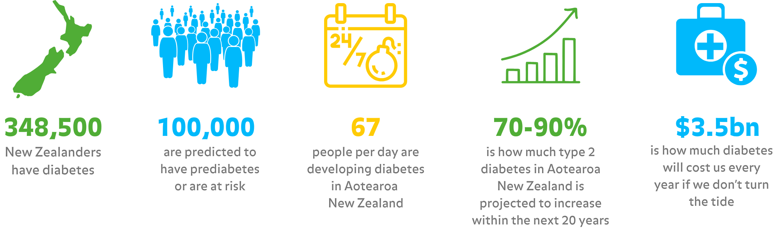
What is Diabetes?
Notes:
Diabetes is a condition where the level of glucose (sugar) in your blood is too high.
If not controlled, high blood glucose levels eventually lead to damage in many parts of your body.
67 People per day are developing diabetes in New Zealand, with a projection of 70-90% increase over the next 20 years ( https://www.diabetes.org.nz/ ) – this is not only extremely morally concerning considering the medical outcomes of those affected, but also the economic impact it will have – costing a predicted $3.5bn every year, if we can’t do something about it. Naturally, this makes the field prime for statistical analysis, with the intent of determining reliable predictive methods, and consequent preventative measures.

Slide 3
Dataset source and description
‘diabetes_prediction_dataset.csv’ dataset
Obtained from Kaggle by author Mohammed Mustafa
Containing 100,000 unique patient records
Collection of medical and demographic patient data
Comprising of a mixture of categorical, binary, and continuous variables
Notes:
For this study I will be using a the ‘diabetes_prediction_dataset.csv’ dataset, obtained from Kaggle by author Mohammed Mustafa.
Containing 100,00 unique patient records, It is a collection of medical and demographic patient data, comprising of a mixture of categorical, binary, and continuous variables.

Slide 4
Dataset source and description
Features:
Age
BMI
Hypertension
Heart Disease
Smoking History
HbA1c Level
Blood Glucose Level
Diabetes (dependant variable)
Notes:
To contextualise a few of these variables:
BMI (Body Mass Index) This is a measurement of height and weight, and is often used to determine risk of heart attack and stroke, and whilst alone is not a reliable indicator of overall health, higher BMI’s are commonly associated with health complications
Hypertension
Also known as high blood pressure, this is a long-term condition in which the force of blood against artery walls is consistently too high, and linked with many negative health concerns.
Heart Disease
A broad term for various conditions and diseases affecting the heart and blood vessels
HbA1c Level
Also known as glycated haemoglobin, this measurement is used to indicate average blood glucose levels over 2-3 months, used to test or diagnose diabetes.
Blood Glucose Level
This refers to amount of blood sugar levels found in a specific sample. Often performed in timed pairs as another means of testing/diagnosing diabetes.

Slide 5
Dataset source and description
Tidiness?
Statistical Measures?
Authenticity?
Notes:
This dataset is tidy, with each row representing a unique individual, and each column representing a distinctive category. It supports the the exploration of several key statistical measures, including: Measures of central tendency, Measures of dispersion and Correlation.
The dataset is claimed to be genuine, however the author has declined to provide information on collection strategy, source, etc, which both raises ethical concerns, and questions its validity.
With this in mind – depending on the realistic nature of the data – it may be useful for learning and study, but not so much for scientific reporting and practical predictive models.

Slide 6
Research Intent
Purpose
To explore the relationships between demographic, lifestyle, and health-related factors associated with diabetes, and heart disease
Identify patterns and correlations between these factors
Notes:
The purpose of this study is to explore the relationships between demographic, lifestyle, and health-related factors associated with diabetes, and heart disease. Both of these conditions present major global health concerns, and often appear to share overlapping risk factors.
Using the acquired dataset, this analysis intends to identify patterns and correlations between these factors, and by effect, gaining a greater understanding of health risks within the sample population.

Slide 7
Data Exploration, Analysis and Testing
Statistical inference
Hypothesis testing and p-values
R Studio
Packages: “here” "ggplot2" "dplyr"
Notes:
This study will employ statistical inference techniques to test for relationships between health factors and diabetes outcomes.
Hypothesis testing and p-values will be applied to support evidence-based conclusions regarding diabetes related risk factors, with intent to find meaningful insight into potential correlations.
All data cleaning, analysis, visualisations, and testing will be conducted in R Studio, utilising the following packages:
- “here” - "ggplot2" - "dplyr"

Slide 8
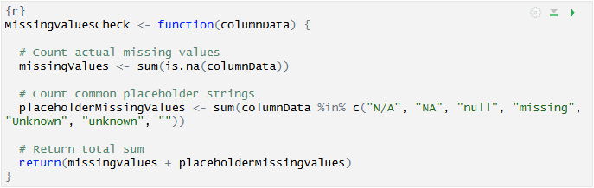
Data Cleaning and Preparation
Missing Values
Data Validation
Notes:
For each feature we need to ensure there are no missing values, for which a custom reusable function was written, that would comprehensively identify null or missing values per feature, using both R’s default ‘is.na()’ function, and a search for common string placeholders, including: "N/A", "NA", "null", "missing", "Unknown", "unknown", "". With the exception of Smoking History, which will be covered in more depth, no missing values were found in the dataset.
Each feature would also require manual data validation, with methods varying per feature.

Slide 9
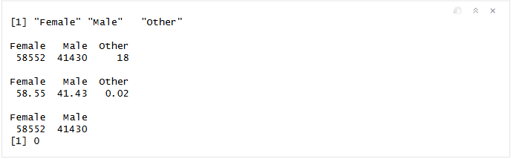
Data Cleaning and Preparation
Gender
“Other” values observed
0.02% of dataset population
Notes:
Gender Whilst no missing values were found, “Other” values were identified. A quick density check highlighted this category made up only 0.02% of the population, and so was removed from the dataset, two provide a cleaner two-category feature.

Slide 10
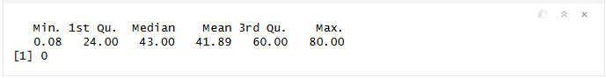
Data Cleaning and Preparation
Age
Plausibility check required
No values lower than 0
No values greater than 120
Notes:
Age
A plausible value check was conducted, ensuring no values fell below 0, nor above a generous 120, via the summary() function. This highlighted a minimum recorded age of 0.8, and max of 80 – well within the realm of plausibility.

Slide 11

Data Cleaning and Preparation
Hypertension, Heart Disease and Diabetes.
Check for non-binary values
Notes:
Hypertension, Heart Disease and Diabetes.
A unique() check ensured no non-binary values were recorded.

Slide 12
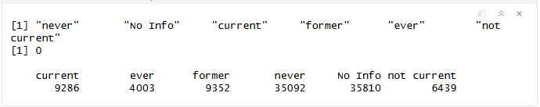
Data Cleaning and Preparation
Smoking History
“No Info” category identified
35% of population
Potentially overlapping features
Notes:
Whilst the missing value function returned no missing values, a unique() check did identify a “No Info” category. Density checks showed these accounted for approximately 35% of the population, and so was deemed unsafe to remove, and was instead flagged for further analysis during visualisations.
The unique() check also identified potentially overlapping features; “former”, “not current”, “current”, and “ever”. “former” and “not current” were, as per author clarification, representing individuals who had not smoked for an unmeasured, ‘considerable amount of time’, versus “not at the current time”, respectively.
“ever”, encompassed those who had smoked at some point in their lives, encompassing both current and former smokers.
These four categories all represent individuals who actively, or at some point in their lives have smoked, and could warrant combination for specific analysis.
This confusing manner of recording the category highlights the features potential unreliability for later consideration.

Slide 13
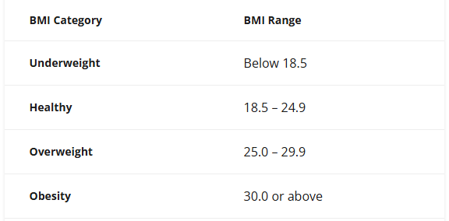
Data Cleaning and Preparation
BMI
Plausibility validation
Notes:
Once again, it was crucial to evaluate plausible values to ensure no implausible extremities exist. (https://www.nhlbi.nih.gov/calculate-your-bmi):
Given the nature of the dataset though, further research ( https://pmc.ncbi.nlm.nih.gov/articles/PMC1890993/) showed the prevalence of of >40 BMI measurements for individuals with diabetes, so we would be interested in values exceeding this amount, or below 18.5.

Slide 14
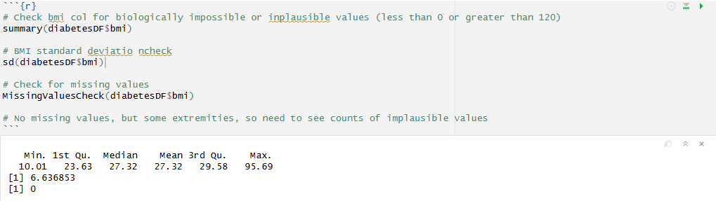
Data Cleaning and Preparation
BMI
Plausibility validation
Notes:
A feature summary demonstrated a minimum value of 10.1, and maximum value of 95.69. With a mean value of 27.32 and a standard deviation of 6.6, most values fall between about 20.7 and 33.9, showing moderate variation, thus this feature was largely considered reasonable and only the outliers warranted further examination.

Slide 15
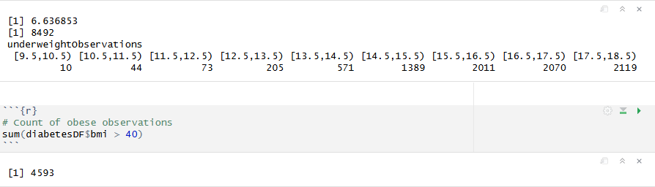
Data Cleaning and Preparation
BMI
Plausibility validation
Notes:
A check of ‘underweight’ records ( < 18.5 ) showed a substantial amount ( nearly 8% of population) Bucketing these records by unit measurement of 1, showed the sum of records significantly weaning off towards the minimum observation; these figures, while improbable, were not impossible, and given unreliability of BMI, were deemed admissible.
Likewise, a check of ‘obese’ observations ( > 40) demonstrated 4593 results. Whilst these figures are typically improbably, they are still not impossible; Additional research into plausible ranges revealed historical cases of extreme obesity with BMI ranges in excess of 100, so, the outliers above this threshold were again deemed admissible.

Slide 16

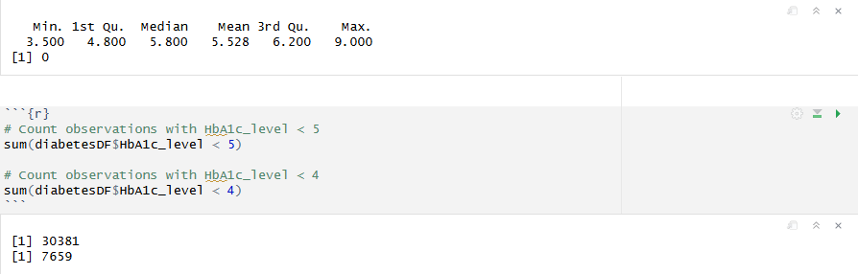
Data Cleaning and Preparation
HbA1c Level
Notes:
Plausible values for this range tend to lie between 5 and 10 (https://diabetes.org/about-diabetes/a1c) .
A summary of this feature revealed no values exceeding this range, however a demonstrated a minimum value of 3.5.
Though a health HbA1c level is considered between 5 to 5.7, lower values are still plausible – a sum of counts less than 5 returned 30,381 observations, and less than 4 revealed 7659 observations, still a considerable portion of the population.
These figures are certainly improbable – lower than 4 in particular have a reportedly low mortality rate, however, further knowledge of the study participants would be required to ultimately determine the validity of data, and thus given the high density, the records were once again deemed admissible.

Slide 17
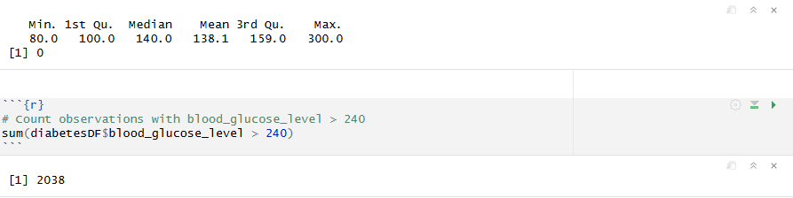
Data Cleaning and Preparation
Blood Glucose Level
Plausibility check
Notes:
Last but not least, this feature’s ranges can be recorded as low as 55 in patients with hypoglycaemia (low blood sugar)
( https://www.cdc.gov/diabetes/treatment/treatment-low-blood-sugar-hypoglycemia.html#:~:text=If%20your%20blood%20sugar%20drops,treat%20severely%20low%20blood%20sugar ),
however the summary of this feature revealed no observations lower than 55.
A maximum of 300 though warranted further examination, given the concerning nature of a reading of more than 200 (https://www.mayoclinic.org/diseases-conditions/diabetes/diagnosis-treatment/drc-20371451? ).
Further research ( https://diabetes.org/living-with-diabetes/treatment-care/hyperglycemia )
demonstrated in patients with hyperglycaemia (high blood sugar) readings exceeding 240 though, for which this feature contained 2038 counts. Notably a lot of cases, but, given this is a study involving diabetes, these values are certainly plausible enough to warrant admission.

Slide 18
Descriptive Exploration
Categorical & Binary Features
Notes:
To gain understanding of how categorical features related the the presence of diabetes, proportions of diabetic vs non-diabetic patients were visualised across gender, hypertension, heart disease, and smoking history.

Slide 19
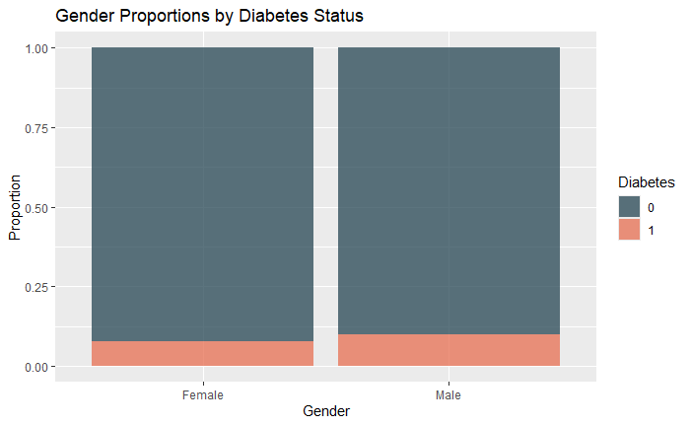
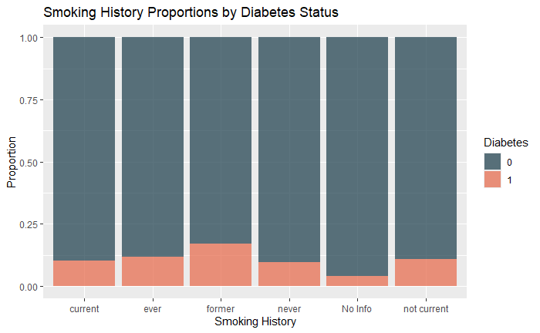
Descriptive Exploration
Categorical & Binary Features
Notes:
Gender: The proportion of diabetes was slightly higher among males than females, though, the difference was minor.
Smoking History: Here we could observe a varied distribution, with “ever”, “former”, and “current” smokers showing higher proportions than those who had reportedly never smoked.

Slide 20
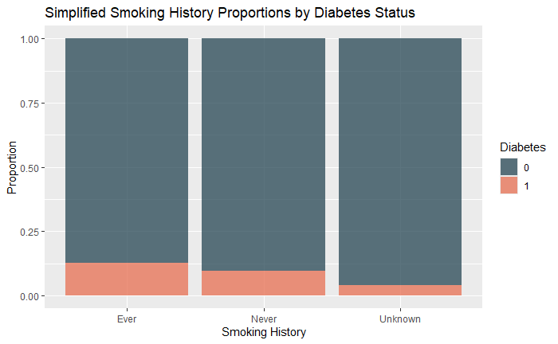
Descriptive Exploration
Categorical & Binary Features
Notes:
To simplify the comparison, a new data frame was generated, grouping the feature into “ever”, “never”, and “unknown” categories, confirming those who have smoked at any point, current or otherwise, demonstrated a higher proportion of diabetes risk.

Slide 21
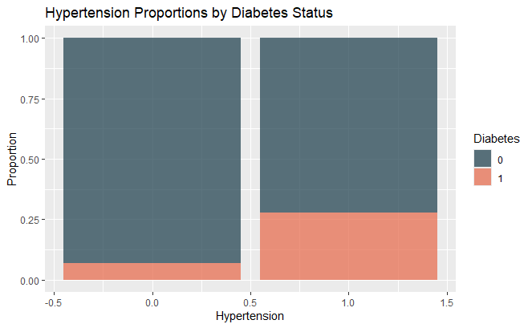
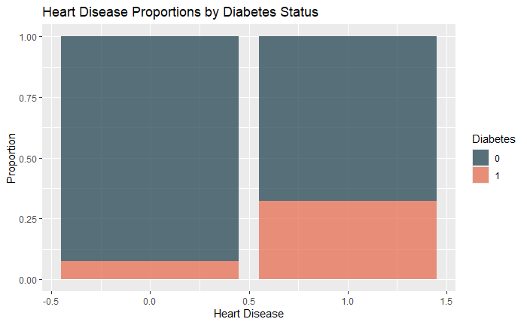
Descriptive Exploration
Categorical & Binary Features
Notes:
Hypertension & Heart Disease: Patients with hypertension showed a substantially higher proportion of diabetes, with Heart Disease showing a more significant proportion again, indicating a strong likelihood of relationship between these variables and risk of diabetes.

Slide 22
Descriptive Exploration
Continuous Features
Notes:
To visualise the distribution of our continuous features, via distribution shape and summary statistics, density and box plots were generated for Age, BMI, HbA1c Level and Blood Glucose Level, comparing diabetic and non-diabetic groups within the population.

Slide 23
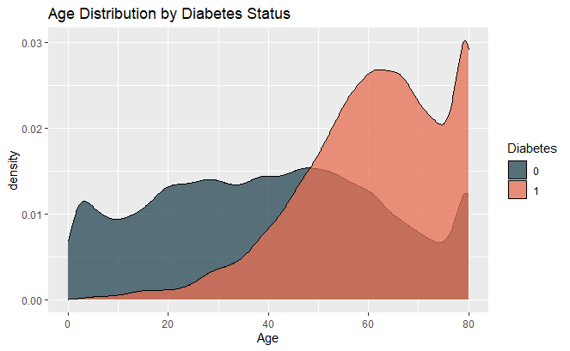
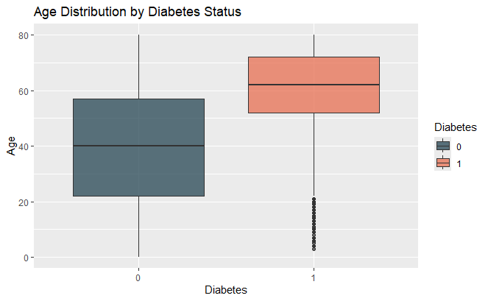
Descriptive Exploration
Continuous Features
Notes:
Age: The density plot demonstrates a right-skewed distribution among diabetics, with most cases manifesting in older age groups (peaking near 60-80), whilst non-diabetics are distributed more uniformly across all ages.
The boxplot reinforces this, showing a higher median age (60-65) and a narrower overall interquartile range in diabetics.
From these plots we can see diabetes risk increases significantly with age, with the elderly comprising the majority of diabetic cases.

Slide 24
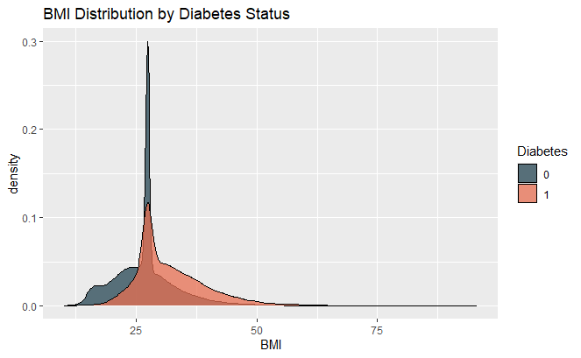
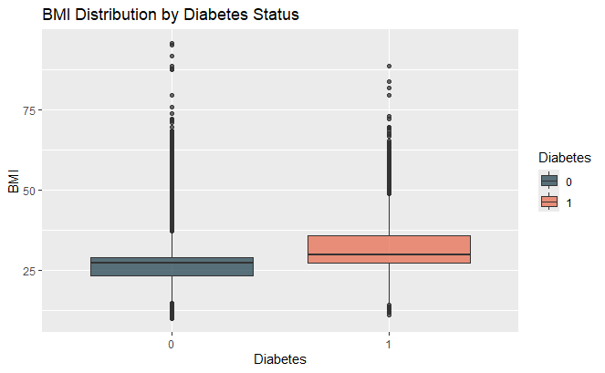
Descriptive Exploration
Continuous Features
Notes:
BMI: Density shapes show clear overlap, but distinctive distributions for diabetics and non-diabetics alike. Both right-skewed, but with diabetic having a flatter curve branching out toward higher BMI values.
This difference was confirmed in the boxplot, with diabetics displaying a higher median BMI (around 30, vs somewhere closer to 25) and slightly more variability.
Diabetics appear to have greater variability, among higher BMI’s, suggesting a connection between obesity and diabetes risk.

Slide 25
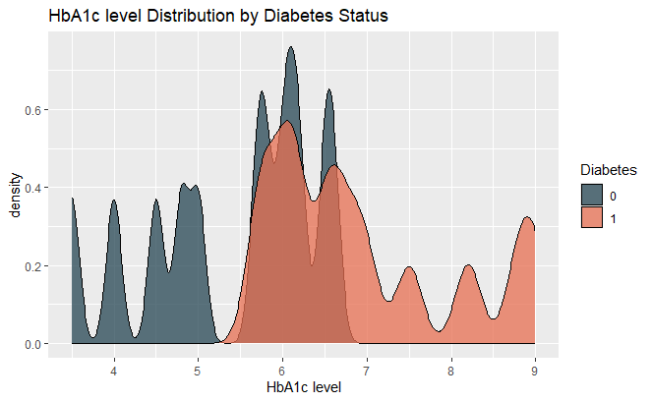
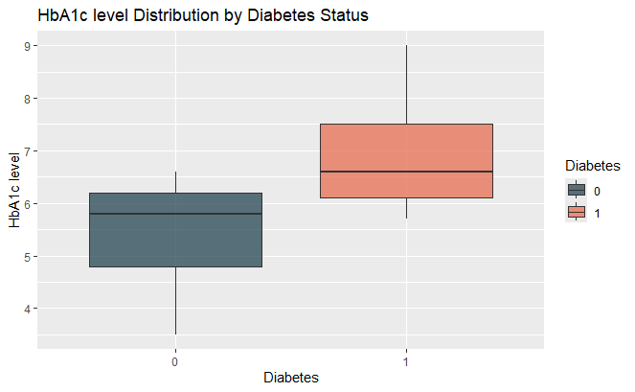
Descriptive Exploration
Continuous Features
Notes:
HbA1c Level: Density plot illustrate two distinctly separated peaks, with non diabetics largely clustered around 4.5-6.5%, and diabetics around 6.5-8%.
Our box plot reaffirms this separation, with diabetics displaying both higher median values, with very little overlap between the two groups.
As anticipated, HbA1c is thus far the strongest differentiating indicator of stroke risk, in line with medical diagnosis, given this measurement is specifically a test to diagnose diabetes.

Slide 26
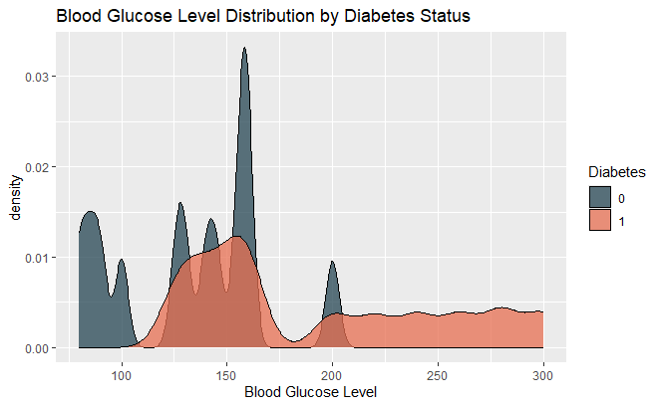
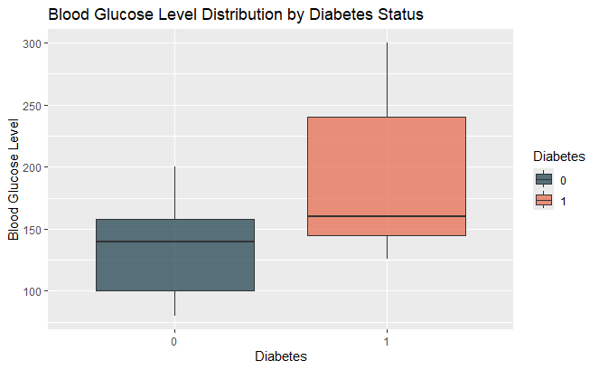
Descriptive Exploration
Continuous Features
Notes:
Blood Glucose Level: Our final density plot reveals relatively tightly clustered glucose levels (100-160) among non-diabetics, in contrast to a broader, right-skewed spread for diabetics, extending beyond 300.
Boxplots once again confirm a higher median, and much wider inner quartile range for diabetics.
These findings further support the connection between glucose levels and diabetes, mirroring the HbA1c findings.
Across all continuous features, we can observe distinctive distributional shapes, wit the differences in medians and variability confirmed by the relevant box plots.
Our Diabetic group consistently demonstrate higher central tendencies, and right-skewness, telling a story of diabetes as a condition linked to multiple factors, including strong relationships with age, weight, and glucose irregularities.

Slide 27
Descriptive Exploration
Inter-feature relationships
Notes:
Switching focus now, having established the independent relationship with each feature and diabetes, we next need to explore possible inter-feature relationships, starting with age.

Slide 28
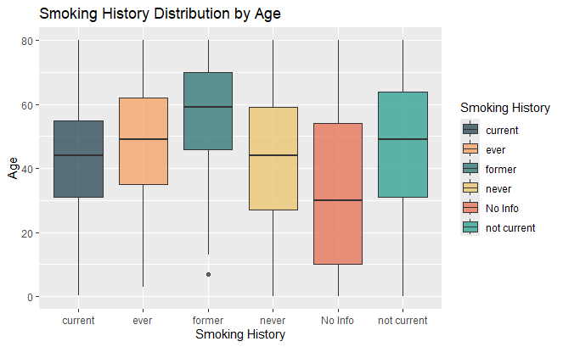
Descriptive Exploration
Inter-feature relationships
Notes:
Age vs Smoking History: The median age here varies noticeably among the smoking history categories.
Former, Not current, and ever categories occupy the older ages, with current and never observations occurring in middle ages.
No Info observations have the widest variance, and the inner quartiles ranging much further into younger patients, hinting at missing data for those whom would not have been screened for this feature.

Slide 29
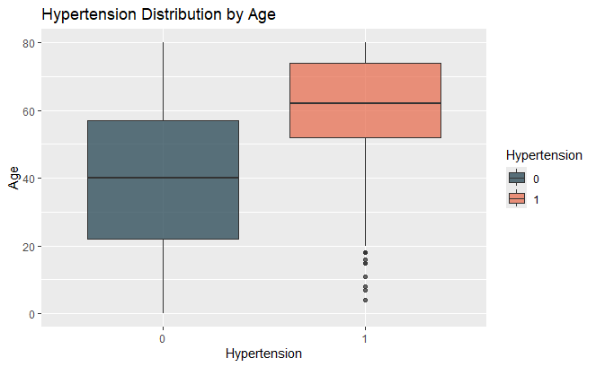
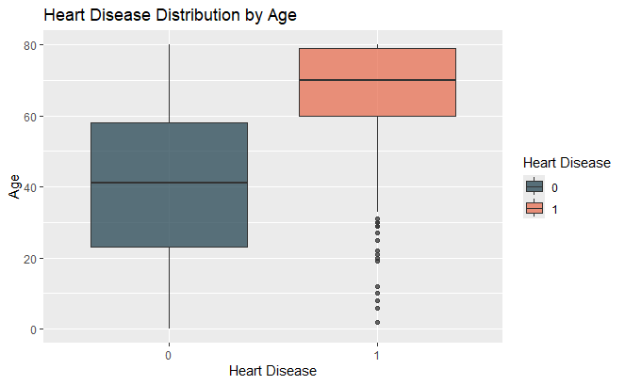
Descriptive Exploration
Inter-feature relationships
Notes:
Age vs Hypertension: Hypertension displays a clear age correlation, with individuals displaying a substantially higher median age (around 65) and smaller interquartile range than those without hypertension.
Age vs Heart Disease: Similarly, heart disease box plot demonstrates the cluster of older age groups, and, outliers aside, no interquartile overlap with the much wider non-diseased group, covering a wider age range.

Slide 30
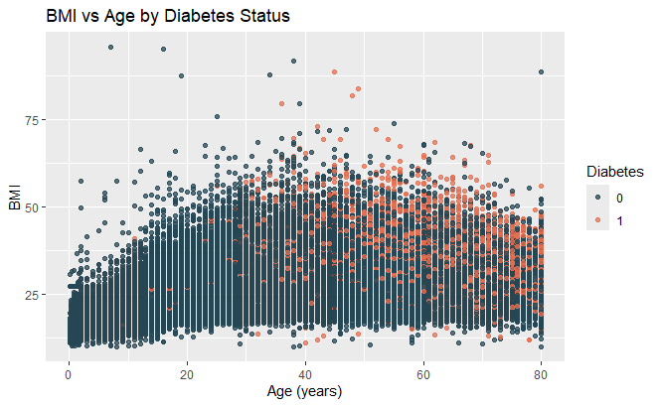
Descriptive Exploration
Inter-feature relationships
Notes:
Age vs BMI: Our final age examination is visualised in a scatterplot, showing the spread of BMI across all ages, color coded to represent diabetics vs non-diabetics.
BMI appears to rise slightly into adulthood, and tapering off in old age, with diabetics appearing in more concentrated clusters in the upper BMI, older age quadrant.
Whilst age and BMI appear to have weak correlation, the combination seemingly contributes to diabetic risk.
Age comparisons revealed meaningful relationships with several key features, particularly hypertension and heart disease, with smoking history also related as a lifestyle factor, reaffirming the risk of diabetes into older ages.

Slide 31
Descriptive Exploration
Inter-feature relationships
Notes:
Next up, furthering our inter-feature analysis, gender was examined in relation to various other features within the population, exploring wither notable differences exist between males and females.

Slide 32
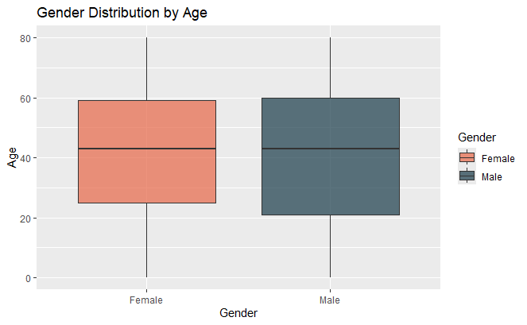
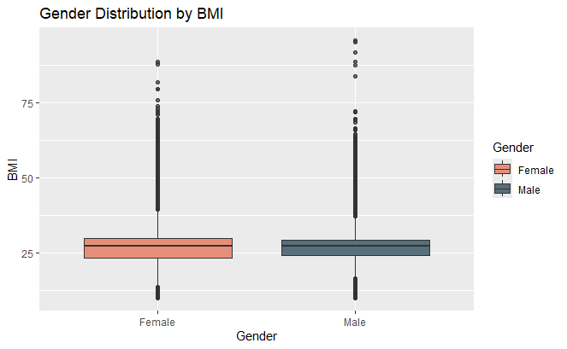
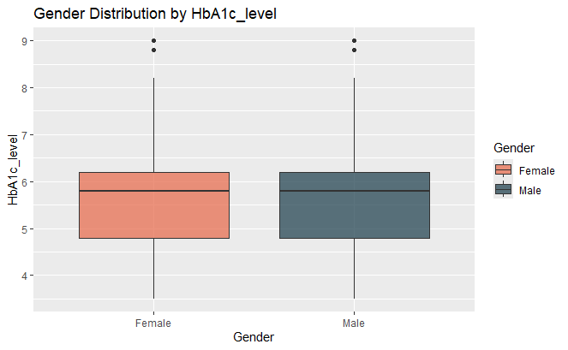
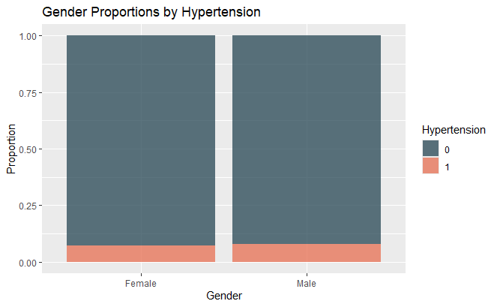
Descriptive Exploration
Inter-feature relationships
Notes:
Gender vs Age, BMI, HbA1c Level and Hypertension: Our first four comparisons against Age, BMI, HbA1c Level and Hypertension, demonstrated near identical medians, spreads and rates, indicative of little to no meaningful relationship.

Slide 33
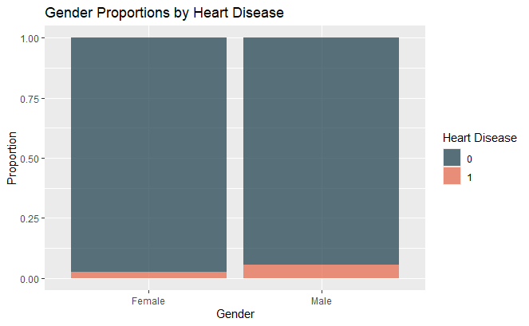
Descriptive Exploration
Inter-feature relationships
Notes:
Gender vs Heart Disease: Though the difference here is small, comparing Heart Disease proportions between the genders revealed slightly higher proportions among males, suggesting the gender group to be at higher risk of developing heart disease.
So, whilst gender differences appear minimal to none across most feature measurements, the modestly higher proportion of heart disease in males,
suggest that although gender does not directly correlate to diabetes risk, it could still prove a determinant risk factor through inter-feature association.

Slide 34
Descriptive Exploration
Inter-feature relationships
Notes:
(Smoking history) As a lifestyle factor known to negatively impact health, smoking history was the next logical relationship to explore, examining its relation to BMI, heart disease and hypertension.

Slide 35
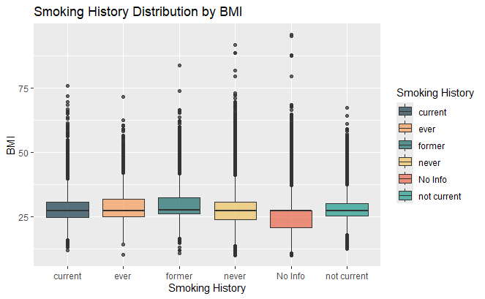
Descriptive Exploration
Inter-feature relationships
Notes:
Smoking history vs BMI: Across all smoking categories, BMI distributions are relatively similar, with medians all clustering around 27, however, the No Info category does present slightly lower BMI values, once again suggesting incomplete records for younger individuals, and, potentially including healthier individuals, for whom this screening was not required.

Slide 36
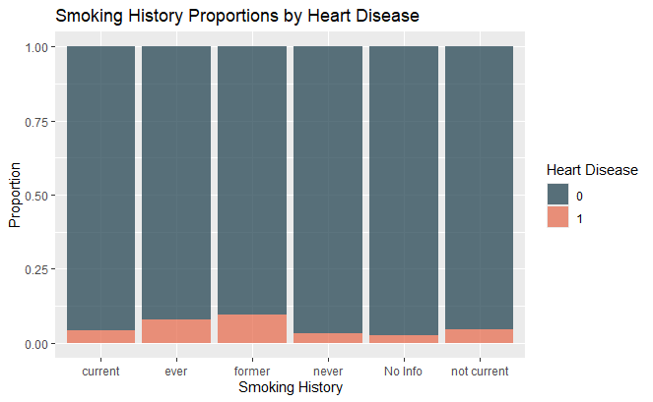
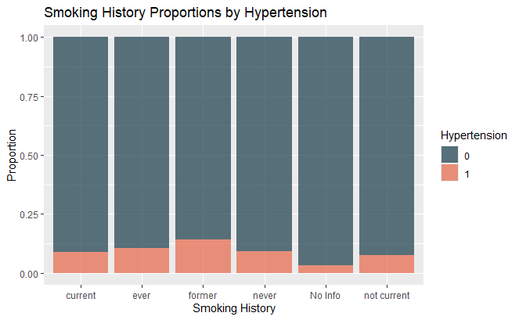
Descriptive Exploration
Inter-feature relationships
Notes:
Smoking history vs Heart disease and Hypertension: Both of these binary features have notably higher proportions amongst ever and former categories, compared to never and no info, suggesting a contribution towards higher blood pressures.

Slide 37
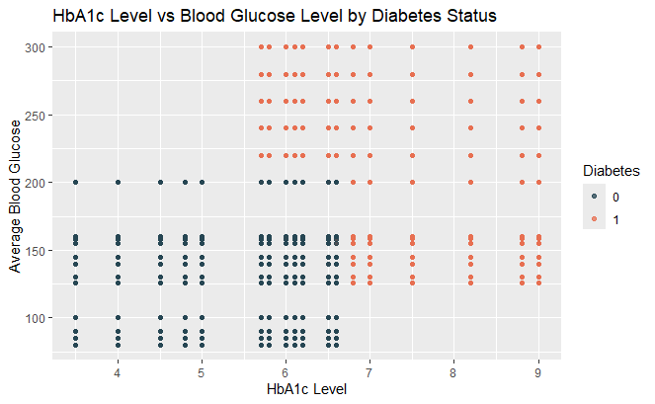
Descriptive Exploration
Inter-feature relationships
Notes:
Lastly, a brief comparison of HbA1c levels and Blood Glucose levels, separated by diabetes was conducted via a scatterplot, demonstrating a clear, upward relationship between the two features,
with non diabetics clustering in the lower left quadrant, with HbA1c values of around 4-6, and typical glucose levels of 100-160, and diabetics contrastingly clustering in the top right quadrant, with elevated HbA1c ranges (6-9) and blood glucose levels (150-300).
This comparison certainly did not break any new ground, given both of these features are well established diabetes measures, however their alignment strengthens the reliability of the datasets representation of its features, authentic or otherwise.

Slide 38

Analysis Summary
Notes:
The exploratory analysis provided a clear overview of the datasets independent, and inter-feature relationships, identifying distinct patterns amongst the various features in relation to each other, and diabetes risk.
However, whilst these discoveries highlight apparent trends, they do not confirm significant statistical difference, and so to validate our observations and assert which relationships could be supported evidentially, a series of inferential tests were next conducted.

Slide 39
Inferential Analysis
Utilising hypothesis testing methods
5% significance level
p-values below this considered statistically significant
Consistent with common health-related research practices
Notes:
Using hypothesis testing methods, this stage examines whether observed differences between the groups are likely to exist within the wider population, or, simply occurred by random chance.
All tests were conducted at a 5% significance level, with p-values below this considered statistically significant. This level indicates a 5% tolerance for false positives, consistent with common health-related research practices.
Together, these tests provide evidence-based confirmation of factors corresponding to diabetes and heart-related risk within the dataset.

Slide 40
Hypothesis Testing
Hypotheses:
BMI differs between diabetic and non diabetic individuals
Heart disease presence differs between gender
Heart disease presence differs between smoking status
Heart disease and diabetes occur independently
Notes:
Based on patterns observed during initial analysis, four targeted hypotheses were developed to gain statistical inference on the strength of the key relationships between the selected features, comparing means and proportions for continuous categorical features respectively.
Specifically, tests were used to examine whether;
BMI differs between diabetic and non diabetic individuals
Heart disease presence differs between gender
Heart disease presence differs between smoking status
Heart disease and diabetes occur independently

Slide 41
Hypothesis Testing
Hypothesis 1: BMI Mean differs between diabetics and non-diabetics.
H₀: The BMI mean is the same for diabetics and non-diabetics
H₁: The BMI mean differs between diabetics and non-diabetics
Notes:
For our first hypothesis, we want to evaluate whether BMI is linked to diabetes, for which we will use the t-test method, given BMI is a continuous feature, and diabetes binary.

Slide 42
Hypothesis Testing
Hypothesis 1: BMI Mean differs between diabetics and non-diabetics.
H₀: The BMI mean is the same for diabetics and non-diabetics
H₁: The BMI mean differs between diabetics and non-diabetics
Notes:
We first run a quick summary, to visualise the number of samples, mean and standard deviation of each group, which shows us that on average, individuals with diabetes exhibit a higher BMI of around 32% vs 27% for those without.

Slide 43
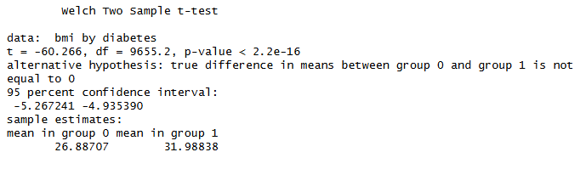
Hypothesis Testing
Hypothesis 1: BMI Mean differs between diabetics and non-diabetics.
H₀: The BMI mean is the same for diabetics and non-diabetics
H₁: The BMI mean differs between diabetics and non-diabetics
Notes:
We can now run our t-test; We can see a monumental standardised difference between the two sample means via our t-statistic of -60.27, which is far removed from what could be produced by random chance.
We can also infer extremely reliable estimations with a very large degree of freedom of 9,655.

Slide 44
Hypothesis Testing
Hypothesis 1: BMI Mean differs between diabetics and non-diabetics.
H₀: The BMI mean is the same for diabetics and non-diabetics
H₁: The BMI mean differs between diabetics and non-diabetics
Notes:
With an extremely small p-value, far less than 0.05, we have strong evidence that diabetics and non-diabetics do not share the same average BMI, and thus we reject the null hypothesis.

Slide 45
Hypothesis Testing
Hypothesis 2: Proportion of heart disease cases differs between genders.
H₀: The proportion of heart disease cases is the same across genders
H₁: The proportion of heart disease cases differs between genders.
Notes:
For our next hypothesis, we are evaluating whether heart disease presence differs by gender. Since both our features for this test are categorical, the chi-square test will be utilised to identify association between their frequencies.

Slide 46
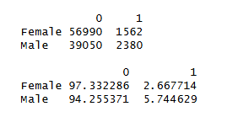
Hypothesis Testing
Hypothesis 2: Proportion of heart disease cases differs between genders.
H₀: The proportion of heart disease cases is the same across genders
H₁: The proportion of heart disease cases differs between genders.
Notes:
As with the last test, we first want to visualise a quick summary to understand the data we are dealing with, which we can do by setting up a cross tab, and manually calculating the proportions.
This immediately demonstrates a 2.7% prevalence of heart disease amongst the female population, compared to 5.7% for males.

Slide 47
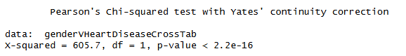
Hypothesis Testing
Hypothesis 2: Proportion of heart disease cases differs between genders.
H₀: The proportion of heart disease cases is the same across genders
H₁: The proportion of heart disease cases differs between genders.
Notes:
Our chi-square test’s x-squared statistic of 605.7 is very large, reassuring us that the observed differences are far beyond random chance provision. The p-value is once again extremely small, essentially zero, and far less than 0.05;

Slide 48
Hypothesis Testing
Hypothesis 2: Proportion of heart disease cases differs between genders.
H₀: The proportion of heart disease cases is the same across genders
H₁: The proportion of heart disease cases differs between genders.
Notes:
we reject the null hypothesis, indicating there is strong statistical evidence that the proportion of heart disease cases differs between genders.

Slide 49
Hypothesis Testing
Hypothesis 3: Proportion of heart disease cases differs between smoking histories.
H₀: The proportion of heart disease cases is the same across smoking histories
H₁: The proportion of heart disease cases differs between smoking histories.
Notes:
Following the prior established process, we once again rely on the chi-square test for this one, given the categorical nature of our features, and begin with a cross tab and manual proportion calculation.

Slide 50
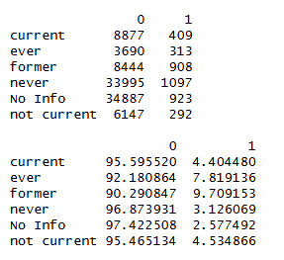
Hypothesis Testing
Hypothesis 3: Proportion of heart disease cases differs between smoking histories.
H₀: The proportion of heart disease cases is the same across smoking histories
H₁: The proportion of heart disease cases differs between smoking histories.
Notes:
As established earlier in the plot visualisations, we can observe a variety of proportions amongst the various smoking history categories, notably a 9.7% presence of heart disease amongst former smokers, and 3.1% to 2.6% for never and no info, respectively.

Slide 51
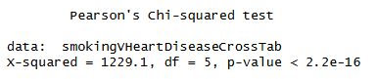
Hypothesis Testing
Hypothesis 3: Proportion of heart disease cases differs between smoking histories.
H₀: The proportion of heart disease cases is the same across smoking histories
H₁: The proportion of heart disease cases differs between smoking histories.
Notes:
Our chi-square test immediately supports this, with an even larger x-squared statistic of 1229.1, and another p-value less than 0.05;

Slide 52
Hypothesis Testing
Hypothesis 3: Proportion of heart disease cases differs between smoking histories.
H₀: The proportion of heart disease cases is the same across smoking histories
H₁: The proportion of heart disease cases differs between smoking histories.
Notes:
we reject the null hypothesis, indicating a statistically significant association between smoking history and heart disease.

Slide 53
Hypothesis Testing
Hypothesis 4: Heart disease and diabetes are independent conditions
H₀: Heart disease and diabetes are independent conditions
H₁: Heart disease and diabetes are not independent
Notes:
Our final test now determines the dependence of our two binary features; our output feature of diabetes, and heart disease, which we have now established links to in regards to both gender and smoking history.

Slide 54
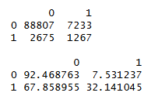
Hypothesis Testing
Hypothesis 4: Heart disease and diabetes are independent conditions
H₀: Heart disease and diabetes are independent conditions
H₁: Heart disease and diabetes are not independent
Notes:
All good things come in threes; we will be using the chi-squared test for our final test, and once again begin with a cross tab and proportion calculations,
which once again provides immediate notable observational difference of 32.1% prevalence of diabetes in those with heart disease, vs 7.6% for those without.

Slide 55
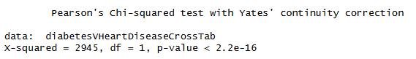
Hypothesis Testing
Hypothesis 4: Heart disease and diabetes are independent conditions
H₀: Heart disease and diabetes are independent conditions
H₁: Heart disease and diabetes are not independent
Notes:
Our chi-squared test provides the strongest x-squared statistic yet of 2945, and, a p-value of less than 0.05;

Slide 56
Hypothesis Testing
Hypothesis 4: Heart disease and diabetes are independent conditions
H₀: Heart disease and diabetes are independent conditions
H₁: Heart disease and diabetes are not independent
Notes:
we reject the null hypothesis, indicating the association between the two features is statistically significant, indicating that diabetes and heart disease frequently co-exist.

Slide 57
Conclusion(s)
Diabetic individuals exhibited a substantially higher BMI mean than non-diabetics (p < 0.05)
Heart disease prevalence was significantly higher among males (p < 0.05)
Heart disease prevalence was moderately higher among individuals who reported any smoking history (p < 0.05)
Diabetes and heart disease were found to be strongly related (p < 0.05)
Notes:
The visual and inferential analyses revealed multiple statistically significant relationships within our dataset;
Diabetic individuals exhibited a substantially higher BMI mean than non-diabetics (p < 0.05)
Heart disease prevalence was significantly higher among males (p < 0.05)
Heart disease prevalence was moderately higher among individuals who reported any smoking history (p < 0.05)
Diabetes and heart disease were found to be strongly related (p < 0.05)
These findings align with pre-established medical research linking diabetes with obesity, and heart related issues.
Despite concerns of the datasets authenticity, the relationships remain statistically valid, supporting the reliability of the dataset for further study, and potential for predictive model training.

Slide 58
Future Analysis
Dataset authenticity
Dataset features
Predictive modelling
Logistic Regression
Notes:
If I was to further my research within this domain, I would first want to validate the authenticity of the dataset, and potentially find alternative, or complimentary datasets.
Ideal features could include height, weight, and waist circumference measures to more accurately gauge health/obesity, as these would be more reliable than BMI.
Smoking status would ideally be simplified in nature, and, could be extended to support vaping, given the modern increase of vaping vs smoking, to see if it also has a correlation.
I would be curious to dive deeper into the gender exploration, and see if the same differences occur in older age groups of the two genders – as reportedly female hormones can aid in protecting the heart in premenopausal years.
Lastly, I would want to conduct predictive model training on this dataset, an/or alternative or accompanying datasets, and would likely lean towards Logistic Regression, at least initially,
to gain a more nuanced understanding of how the features interact, and determine if accurate risk predictions could be obtained.

Slide 59
References
https://www.diabetes.org.nz/
https://www.nhlbi.nih.gov/calculate-your-bmi
https://pmc.ncbi.nlm.nih.gov/articles/PMC1890993/
https://diabetes.org/about-diabetes/a1c
https://www.cdc.gov/diabetes/treatment/treatment-low-blood-sugar-hypoglycemia.html#:~:text=If%20your%20blood%20sugar%20drops,treat%20severely%20low%20blood%20sugar
https://www.mayoclinic.org/diseases-conditions/diabetes/diagnosis-treatment/drc-20371451
https://diabetes.org/living-with-diabetes/treatment-care/hyperglycemia
Notes:
End (QnA)

